Slide 1
Coffee Chain Sales Analysis Report
A three-year analysis of sales data from 2012 to 2014
Prepared by: Hemaraj K
Date: October 08, 2023

Slide 2
AGENDA
SUMMARY
KEY INSIGHTS
RECOMMENDATION
CONCLUSION

Slide 3
Executive summary:
Key findings:
The most popular coffee products are the Colombian, Lemon, and Caffe Mocha.
The most profitable coffee type are the espresso and coffee.
Sales are increasing over time.
Sales are highest in the West market.
Recommendations:
The coffee chain should focus on promoting its most popular and profitable coffee products.
The coffee chain should expand its hours of operation to capture more sales in the evening.
The coffee chain should open new stores in the West market.

Slide 4
Most Popular Coffee Product:
The most popular coffee products are the Colombian, Lemon, and Caffe Mocha.

Slide 5
Most popular Coffee Type:
The most profitable coffee types are espresso and coffee.

Slide 6
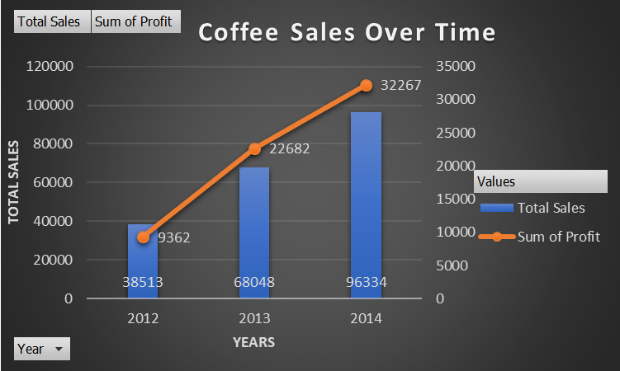
Sales over Time:

Slide 7
Sales by Markets

Slide 8
Recommendations:
The coffee chain should focus on promoting its most popular and profitable coffee products.
The coffee chain should expand its hours of operation to capture more sales in the evening.
The coffee chain should open new stores in the West market.
The coffee Chain should focus on products which need improvement

Slide 9
Conclusion
Based on the findings of this report, the coffee chain should:
Focus on promoting its most popular and profitable coffee products, such as the Colombian, Lemon, and Caffe Mocha.
Focus on improving products that are not selling well.
Expand its hours of operation to capture more sales in the evening.
Open new stores in the West market, where sales are highest.
By implementing these recommendations, the coffee chain can increase its sales and profitability.
In addition to the above, the coffee chain could also consider the following:
Offering loyalty programs to reward customers for repeat business.
Partnering with local businesses to offer discounts or promotions to customers.
Investing in social media marketing to reach a wider audience.
By taking these steps, the coffee chain can position itself for long-term success

Slide 10
THANK YOU
Time for Feedback:
If you’ve any questions you can ask me now
- Hemaraj K

